Slide 1
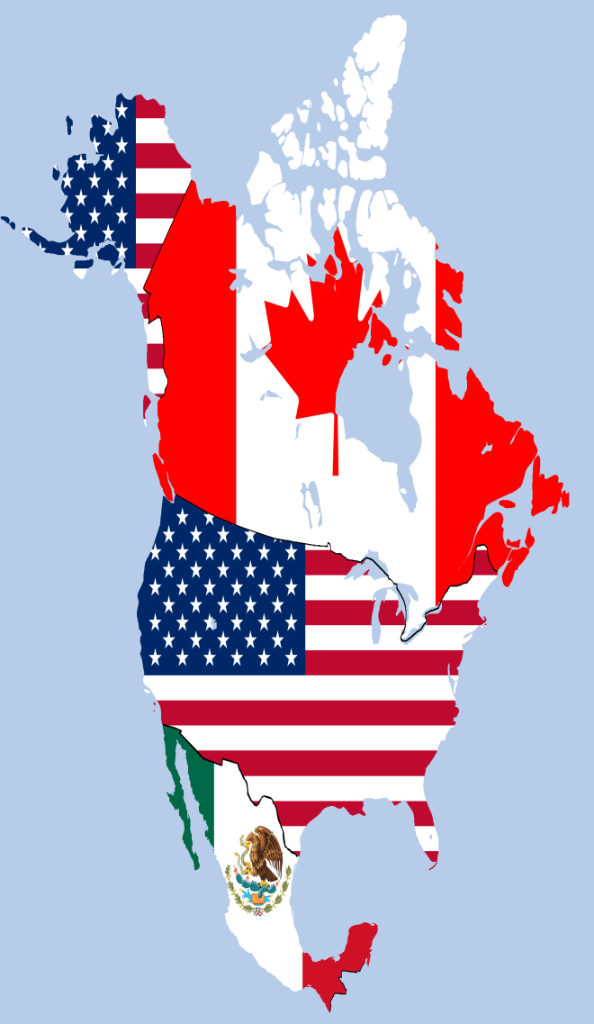
The Open Economy: International Trade and Finance
C+I+G+(X-M)

Slide 2
Too much too fast!!

Slide 3
Lets break this down a bit.
Try Khan Academy
https://www.youtube.com/watch?v=dirBYVjDk7A&list=PLAEA5E9ACA1508F92

Slide 4
Trade Balance
American Exports
In 2013 $1.579 T
In 2014 $2.343 T
Machinery: $213,108,199,000 (13.5% of total exports)
Electronic equipment: $165,604,449,000 (10.5%)
Mineral fuels including oil: $148,426,743,000 (9.4%)
Vehicles excluding trains and streetcars: $133,640,479,000 (8.5%)
Aircraft and spacecraft: $115,380,944,000 (7.3%)
American Imports
In 2013 $2.330 T
In 2014 $2.851 T
Oil $389,300,000,000 (16.7% of total imports)
Machinery $311,200,000,000 (13.4%)
Electronic Equipment $303,500,000,000 (13%)
Vehicles $253,300,000,000 (10.9%)
Medical and Technical Equipment $72,100,000,000 (3.1%)

Slide 5
Current Trade Deficit in November 2014 was -$39 B

Slide 6
Why does the USA trade?

Slide 7
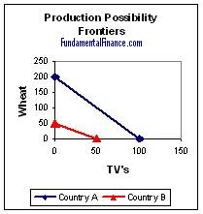
Comparative Advantage
Product | Country A | Country B
Wheat | 200 | 50
TVs | 100 | 50

Slide 8
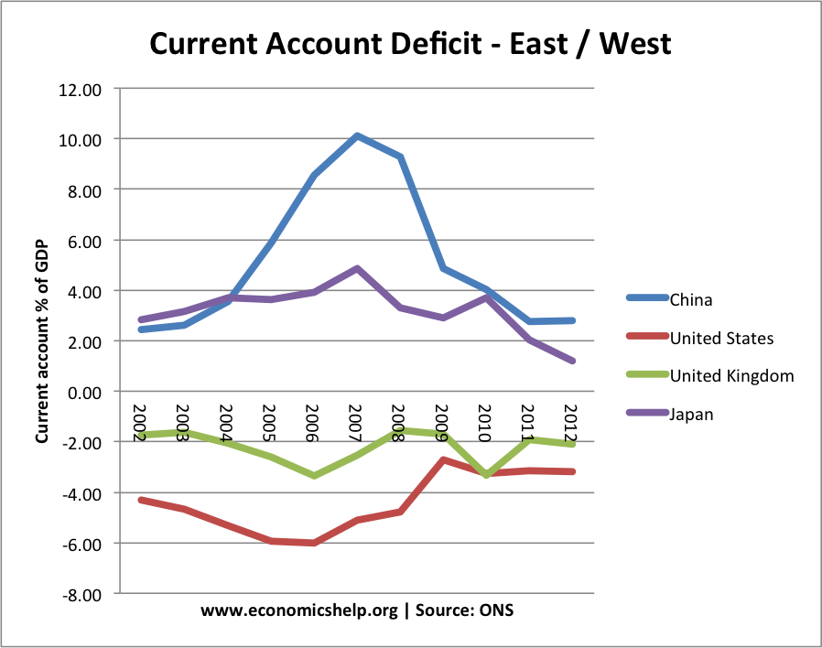
Current Account page #412
Balance of payments on goods and services plus net international transfer payments and factor income

Slide 9
Capital (Financial) Accounts
Measures international sales of financial assets
Stocks, securities, savings bonds
Capital inflows and outflows

Slide 10
Current Account + Capital Account = 0
If there is a current account deficit (X<M) than capital inflows will be greater then capital outflows The Chinese have to invest those US dollars back in America
If there is a current account surplus (X>M) than capital outflows will be greater then capital inflows. (What to do with the foreign currency we hold?)

Slide 11
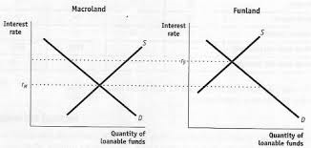
Loanable Funds Market

Slide 12
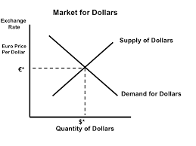
The FOREX Graph

Slide 13
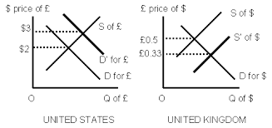
Why does demand shift?
Changes in tastes and preferences
Changes in Price Level
Changes in Income
Changes in Real Interest Rates

Slide 14
Supply and Demand Move Together
What happens when Americans want more Japanese goods?
Dollar Market Yen Market

Slide 15
Currency Value
Appreciation
Depreciation
Demand Increases
Supply Decreases
Foreigners Love American Products
Higher Interest Rates in US
Higher Foreign Inflation Rates
Demand Decreases
Supply Increases
US Cuts taxes
Tariffs on American Products
FED buys government securities

